Slide 1
Object-oriented Programming
Week 7 | Lecture 1

Slide 2

Types of Inheritance
Single Inheritance
Multi-level Inheritance
Hierarchical Inheritance
Multiple Inheritance
Hybrid Inheritance

Slide 3
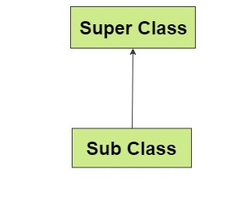
Single Inheritance
When we have a single base class and a single derived class
class A {
// code for base class };
class B: public A
{
// code for derived class };

Slide 4
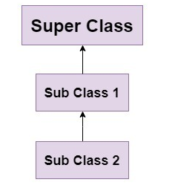
Multi-level Inheritance
When we have a chain of single inheritance between three or more classes
class A {
// code for class A };
class B: public A
{
// code for class B };
class C: public B
{
// code for class C }; // …. any more classes in this chain

Slide 5
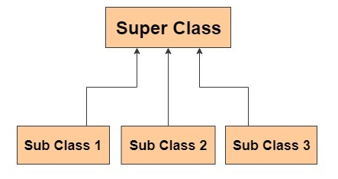
Hierarchical Inheritance
When we have more than one derived classes of a single base class
class A {
// parent class };
class B: public A
{
// first child class };
class C: public A
{
// second child class };

Slide 6
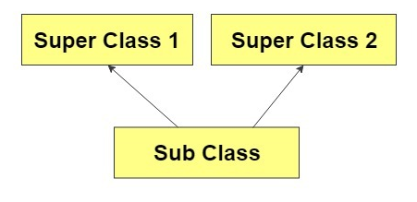
Multiple Inheritance
When we have more than one base class of a single derived class
class A {
// some class };
class B
{
// some other class };
class C: public A, public B
{
// a child class with two parent classes };

Slide 7
Multiple Inheritance
Only C++ has multiple inheritance. JAVA and C# do not allow more than one parent classes
Has several disadvantages when functions are overriden
It is not necessary for two parent classes to use the same access specifier

Slide 8
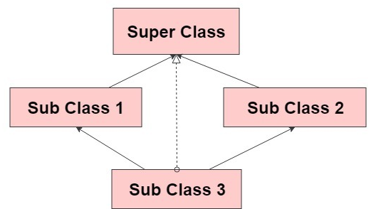
Hybrid Inheritance
When we have more than type of inheritance relationships in a class hierarchy
class A {
// some class };
class B: public A
{
// child of A
};
class C: public A
{
// child of A
};
class D: public B, public C
{
// child of B and C };

Slide 9

Issue
The type of hybrid inheritance shown in the previous example can lead us to an infamous issue called “Diamond Problem”

Slide 10
Advantages of Inheritance
Allows software reuse
Reduces code redundancy
Allows logical relationships between entities (objects)

Slide 11
Disadvantages of Inheritance
If done wrong, can be disastrous for the entire program/software
Change in one class can sometimes affect other classes

